Slide 1
CYB 110 CYBERSECURITY AND PRIVACY MODULE 8 - HUMAN ELEMENT SECURITY JIM ALVES-FOSS AND JIA SONG

Slide 2
HUMAN ELEMENT SECURITY
"People often represent the weakest link in the security chain and are chronically responsible for the failure of security systems." [1]
For example
People click dangerous links
Send sensitive information via unprotected channels
Write down passwords on sticky notes
Share passwords with other people
Post personal data online
Download and open unknown email attachments
[1] Book: “Secrets and Lies: Digital Security in a Networked World”, by Bruce Schneier, 2000

Slide 3
OUTLINE
Human element security
Password attacks
Social engineering

Slide 4
OUTLINE
Human element security
Password attacks
Social engineering

Slide 5
PASSWORD STATISTICS (2020)
The most popular passwords are extremely easy to guess
abc123, Password, 123456, Iloveyou, 111111, Qwerty, Admin, Welcome.
59% use their name or birthdate in their password
43% have shared their password with someone
20% have shared their email account password
Only 45% would change a password after a breach
42% of organizations rely on sticky notes for password management
Almost two-thirds of people use the same password across multiple accounts
Source: https://www.comparitech.com/blog/information-security/password-statistics/

Slide 6
ATTACKING PASSWORDS
12 steps an attacker might try to determine a password
No password
The same as the user ID
Is, or is derived from, the user’s name
On a common word list (password, secret, private) plus common names and patterns (aaaaaa, qwerty)
Contained in a short college dictionary
Contained in a complete English word list
Contained in common non-English-language dictionaries

Slide 7
ATTACKING PASSWORDS
8. Contained in a short college dictionary with capitalizations (PaSsWorD) or substitutions (digit 0 for letter O, digit 5 for letter S)
9. Contained in a complete English dictionary
10. Contained in common non-English dictionaries
11. Obtained by brute force, trying all possible combinations of alphabetic characters
12. Obtained by brute force, trying all possible combinations from the full character set

Slide 8
TWO MOST COMMON WAYS OF GUESSING PASSWORDS
Dictionary attacks
A dictionary attack uses a file containing words, phrases, common passwords, and other strings that are likely to be used as a password.
Brute-force attacks
A brute-force attack tries every possible combination of characters up to a given length.

Slide 9
BRUTE FORCE GUESSING OF PASSWORDS
Brute force password attack - A method of accessing an obstructed device through attempting multiple combinations of numeric and/or alphanumeric passwords [NIST].
In an exhaustive or brute force attack, the attacker tries all possible passwords, usually in some automated fashion.
Guessing probable passwords
-- For passwords of length 3 or less (not case sensitive, letters only):
26 + 26*26 + 26*26*26 = 18278 possible passwords
1 password guess per millisecond – 18.278 seconds
-- 4 characters – 475 seconds
-- 5 characters – 12,356 seconds (3.5 hours)

Slide 10
ATTACKING PASSWORDS
Dictionary attacks – using words in dictionary.
Inferring passwords likely for a user
People usually use personal information (birthday, names, pet’s name) in passwords.
Password spraying – certain passwords against many accounts.
A form of brute-force attack that attempts to use a single password or small set of passwords against many accounts.

Slide 11
CONCEALED PASSWORDS
Operating systems store passwords in encrypted form so that compromising the ID-password list does not give immediate access to all user accounts.
When a user creates a password, the operating system accepts and immediately conceals it, storing the unreadable version.
When the user attempts to authenticate, the typed string will be concealed and compare with the stored one.
Forgot your password? Only reset.
Wrong passwords attempts, lock the account.

Slide 12
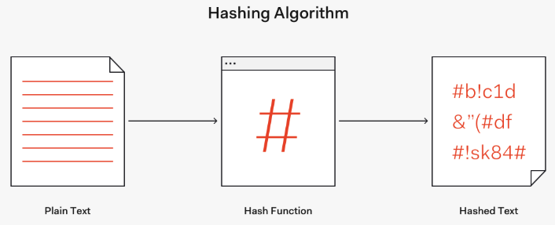

PASSWORD HASHING
Hashing Password – transform a password into data that cannot be converted back to the original password.
Ref: https://auth0.com/blog/hashing-passwords-one-way-road-to-security/
Ref: https://crackstation.net/hashing-security.htm

Slide 13
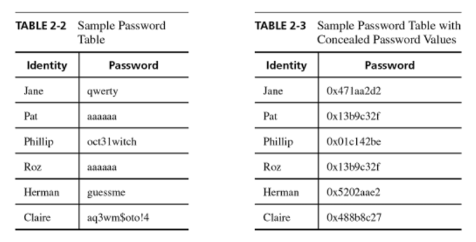
PASSWORD TABLE

Slide 14
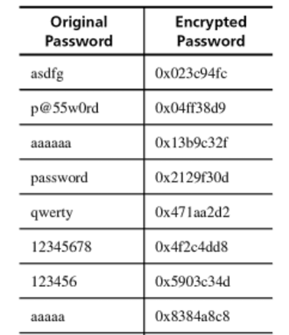
PROBLEM WITH HASHED PASSWORDS
The same string run through the a hash function gets the same output.
If two users have the same password, they'll have the same password hashes.
Rainbow table: precomputed list of popular values, such as passwords.
Look up table
Notes:
What we want: Even if two users have same passwords, the concealed password are different.

Slide 15
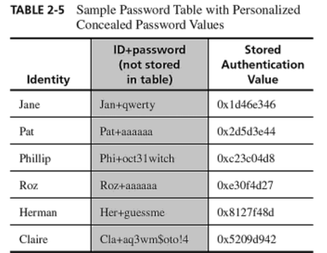
SALT
A Salt is an extra data field different for each user.
Notes:
We can randomize the hashes by appending or prepending a random string, called a salt, to the password before hashing.

Slide 16
SALT
Adding salt makes the same password hash into a completely different string.
Salt is usually stored in the user account database along with the hash.
The salt does not need to be secret. (by randomizing the hashes, the rainbow tables become ineffective.)
Ref: https://auth0.com/blog/hashing-passwords-one-way-road-to-security/
Notes:
An attacker won't know in advance what the salt will be, so they can't pre-compute a lookup table or rainbow table.

Slide 17
TO AVOID PASSWORD ATTACKS
System side:
Require longer and complex passwords, sometimes with symbols (#,$,%,-,!)
Limit failed login attempts
Lock accounts
Multifactor authentication
Limit logins to a specified IP address or range
Use CAPTCHAS to prevent automated attacks
...

Slide 18
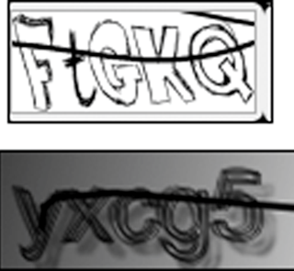
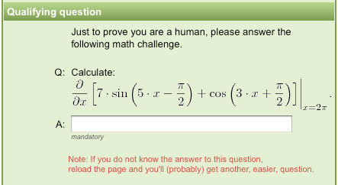
CAPTCHA
A CAPTCHA is a puzzle that supposedly only a human can solve, so a server application can distinguish between a human who makes a request and an automated program generating the same request repeatedly.
Notes:
By using dummy websites to entice users into solving CAPTCHAs, attackers can effectively defeat the CAPTCHAs at scale.

Slide 19
TO AVOID PASSWORD ATTACKS
User side:
Use characters other than just A-Z.
Choose long passwords.
Avoid actual names or words.
Choose an unlikely password.
Change the password regularly.
Don't write it down.
Don't tell anyone else.
Notes:
We have discussed the security methods implemented in the system or database to help protect our passwords.
As a user, good passwords

Slide 20
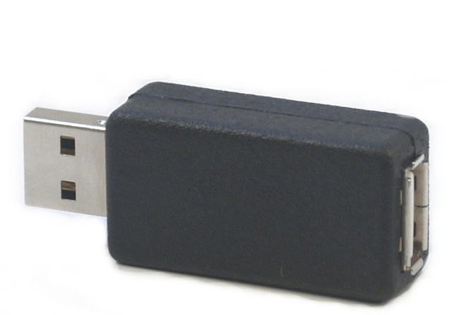
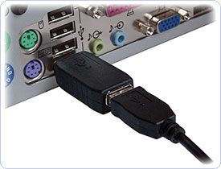
KEYSTROKE LOGGER
A keystroke logger is either hardware or software that records all keystrokes entered.
May be a small object plugged into a USB port or may also be installed as malware
The keystroke logger either retains these keystrokes for future used by the attacker or sends them to the attacker across a network connection.

Slide 21
OUTLINE
Human element security
Password attacks
Social engineering

Slide 22
SOCIAL ENGINEERING
Social engineering attacks manipulate people to gain information or access to facilities, systems, and networks.
Social engineers work to influence their targets to take actions that they might not otherwise have taken.
A successful social engineering attacks may depend on:
Authority - someone who appears to be in charge or knowledgeable.
Trust - a connection with the individual.
Intimidation - scaring or bullying an individual into taking a desired action.
Urgency - creating a feeling that the action must be taken right away.

Slide 23
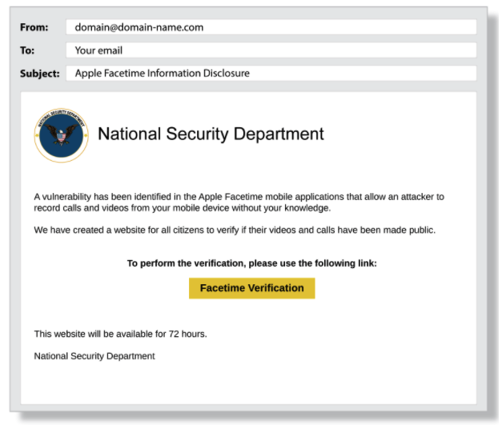
PHISHING
Use of electronic communication, to collect information or install malware. A link to a website may “look” legitimate, but really is faked, and if you enter credentials, the hacker gets them.
Source: https://terranovasecurity.com/top-examples-of-phishing-emails/

Slide 24
PHISHING EMAIL
Phishing victims are tricked into disclosing critical information which should be kept private.
Date of birth
Social security numbers
Phone numbers
Bank account details
Home address
Password information (or what they need to reset your password)
Victims respond with the information because they trust the source.
The information is then used by the attackers to do something else.
login to systems, open bank accounts, other attacks...

Slide 25
PHISHING EMAIL
Phishing emails usually sound urgent that demands urgent action.
Requested actions may include:
Open an attachment in an email
need to update a password
responding to a social media connection request
need to login to an account to do something
click on a link (direct to a spoofed website)
...

Slide 26
TIPS TO STOP PHISHING
Avoid strangers, check name and email address
Don’t rush, be suspicious of emails marked “urgent”
Notice mistakes in spelling and grammar
Beware of generic greetings, “dear sir/ma’am”
Don’t be lured by incredible “deals”
Hover over the link before you click to ensure it has a secure URL (https://)
Never give out personal or financial information based on an email request
Don’t trust links or attachments in unsolicited emails
source: https://www.cisco.com/c/dam/en/us/products/collateral/security/email-security/phishing-program-infographic.pdf

Slide 27
DIFFERENT TYPES OF PHISHING ATTACKS
Spear phishing: A targeted attack that is personalized to a particular recipient or set of recipients. It tempts recipients by seeming to come from sources the receiver knows and trusts.
CEO Fraud: phishing emails with email address familiar to the victim. eg. From company’s CEO, HR manager, IT support team...

Slide 28
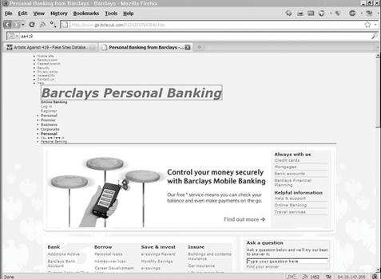
FAKE WEBSITE
Websites are easy to fake because the attacker can obtain copies of the images the real site uses to generate its website.
Fake sites can look convincing.
Typo squatting attacks use misspelled and slightly off but similar to the legitimate site URLs.
Notes:
Example of a fake banking website meant to trick users.

Slide 29

FAKE CODE
Programs intentionally installed that may advertise one purpose but do something entirely different.
A digital signature can vouch for the authenticity of a program, update, or dataset.
Notes:
Example of a software download site meant to trick users into downloading malicious applications.

Slide 30
MALWARE FOR STEALING DATA
Malware can be installed by clicking on an email attachment.
For example: Man-in-the-Browser
A man-in-the-browser attack is an example of malicious code that has infected a browser.
Code inserted into the browser can read, copy, and redistribute anything the user enters in a browser.
The threat here is that the attacker will intercept and reuse credentials to access financial accounts and other sensitive data.

Slide 31
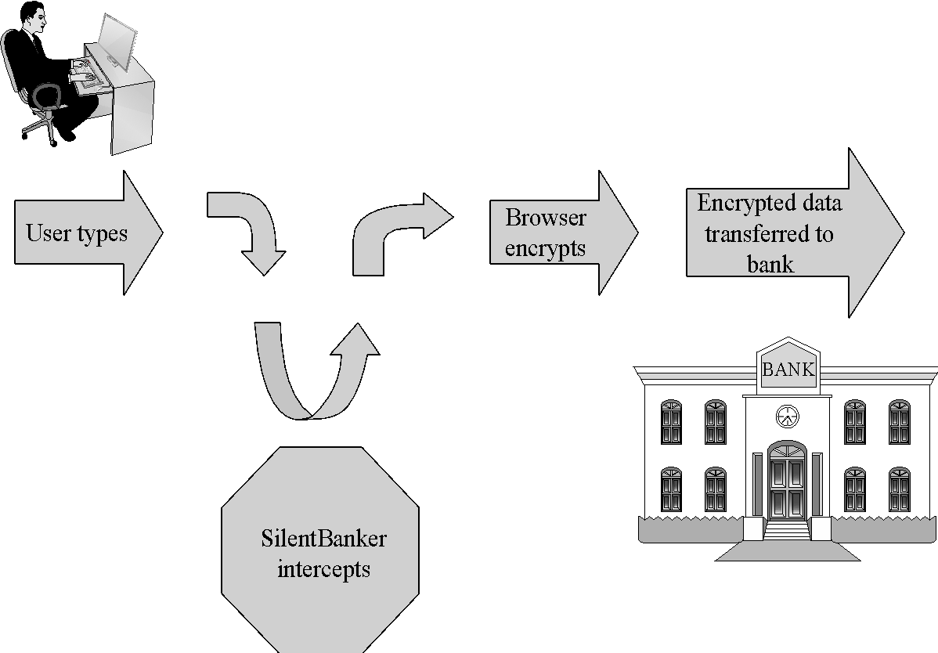
MAN-IN-THE-BROWSER
SilentBanker (Jan 2008) was a Trojan that generally installed as a browser plug-in.
When it detected the user going to a banking URL, it would intercept keystrokes and even modify them so that money transfers would go to attackers’ accounts.
Notes:
It started with a list of over 400 URLs of popular banks throughout the world. When it detected the user going to a banking URL, it would intercept keystrokes and even modify them so that money transfers would go to attackers’ accounts.

Slide 32
DIFFERENT TYPES OF PHISHING ATTACKS
Mobile phishing (Smishing): a fraudulent SMS (text), social media message, voice message or other messages ask the recipient to do something to give their critical information.
Voice Phishing (Vishing): a caller calls or leaves a voice message to urge the victim to do something. They usually sound urgent and convincing.
Spoofed Wi-Fi access point: spoofed Wi-Fi access points where can be accessed “Free”. In shopping mall, airports, coffee shops, parks...

Slide 33
EMAIL SPAM
Spam is unsolicited and unwanted junk email sent out in bulk to a wholesale recipient list.
Typically for commercial purposes but can contain a malicious attempt.
Types of spam: Advertising, malicious code, links for malicious websites.
Spam countermeasures
Laws against spam exist but are generally ineffective
Email filters have become very effective for most spam
Internet service providers use volume limitations to make spammers’ jobs more difficult

Slide 34
OTHER TYPES OF SOCIAL ENGINEERING ATTACKS
Pretexting: This attack is a way to convince people of your legitimacy, using a “pretext”. Eg: family member of an employee, delivery person, member of IT team, or having an urgent need.
Tailgating: People draft in after others into a company, bypassing security. May have faked “badge”, “credentials”, “swipe card” that look legit. When walking through someone may see an unprepared tailgater but seeing the fake credentials will assume that the person came in legitimately.
Desktop Browsing: If you can read upside down and backwards, you can learn a lot of information from someone’s desk.

Slide 35
TRAINING
The best way to improve people-security is training:
Password – increase password security/strength
Social engineering training – Trust but verify
Network usage – Where do people connect to the network, and what do they connect?
Work device on public network
foreign device on enterprise network
Malware
Clean desk policies
Familiarity with policy and regulations

Slide 36
PLEASE ATTRIBUTE DR. JIM ALVES-FOSS AND DR. JIA SONG, UNIVERSITY OF IDAHO EXCEPT WHERE OTHERWISE NOTED, THIS WORK IS LICENSED UNDER HTTPS://CREATIVECOMMONS.ORG/LICENSES/BY-NC-SA/4.0/ NOT WITHSTANDING THE NON-COMMERCIAL LICENSE TERMS, NON-PROFIT EDUCATIONAL INSTITUTIONS ARE GRANTED A NON-EXCLUSIVE LICENSE TO ADAPT AND USE THIS MATERIAL, WITH ATTRIBUTION. CREATIVE COMMONS AND THE DOUBLE C IN A CIRCLE ARE REGISTERED TRADEMARKS OF CREATIVE COMMONS IN THE UNITED STATES AND OTHER COUNTRIES. THIRD PARTY MARKS AND BRANDS ARE THE PROPERTY OF THEIR RESPECTIVE HOLDERS.

